Slide 1

Recommend driving by car
<<includes>>
Carpark API
Get source and destination location
<<includes>>
Recommend public transport
Traffic API
User
<<includes>>
Recommend Taxi
Google Map API
Taxi API

Slide 2


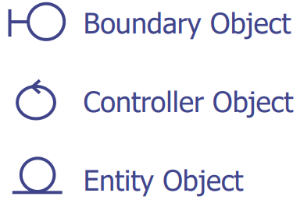
Use case 1: Get source and destination location
MainMenuUI
GmapAPI
User
Open
promptGPS()
Grant
getLocation()
Location
destination
displayLocation()
Confirm
validateLocation()
validLocation

Slide 3

Use case 2: Recommend driving by car
MainMenuUI
BestMode
CarparkAPI
GoogleMapAPI
TrafficImageAPI
User
Valid source and destination location
getTransportMode()
CheckCarpark()
Carpark Information
displayModeOf Transport()
ModeOfTransport
displayCarparkinfo()
Select carpark
Source location and destination carpark
Route
displayRoute()
Show traffic
showTraffic()
Traffic Image
displayTraffic()

Slide 4
Use case 3: Recommend Taxi
MainMenuUI
BestMode
CarparkAPI
TaxiAPI
User
Valid source and destination location
getTransportMode()
checkCarpark()
Carpark Information
checkTaxi()
ModeOfTransport
Taxi information
displayModeOf Transport()
displayTaxiInfo()

Slide 5
Use case 4: Recommend Public Transport
MainMenuUI
BestMode
CarparkAPI
TaxiAPI
GoogleMapAPI
User
Valid source and destination location
getTransportMode()
checkCarpark()
Carpark Information
checkTaxi()
Taxi information
checkPublicTransport()
Public transport information
displayModeOf Transport()
ModeOfTransport
displayPublicTransportInfo()

